Slide 1
Bio466 project 1
Cole Adams & Rachel Curci

Slide 2
INTRODUCTION
Objectives:
Develop a user-friendly SeqViewer in Python integrated with MySQL databases
Improve the ability to access genetic data analysis
Significance:
Addressing data management needs
Facilitating research in a multitude of ways

Slide 3
System overview
MySQL Database
Data storage & retrieval
Graphic User Interface (GUI)
User interaction
User visualization
Python Classes
Backend processing
Goal
Seamless integration
Connection between various components
Efficiency from data input to analysis

Slide 4
GUI buttons
All designed to streamline user interaction
Spacer
Improves readability by breaking long sequences into smaller blocks
Detect CpG Islands
Identifies gene regulation regions
Useful in epigenetic research
Detect Homopolymers
Spots sequence errors and mutations
Useful in genetic disorder research
Motif Search
Locates specific sequences
Useful in understanding gene expression and protein binding sites

Slide 5
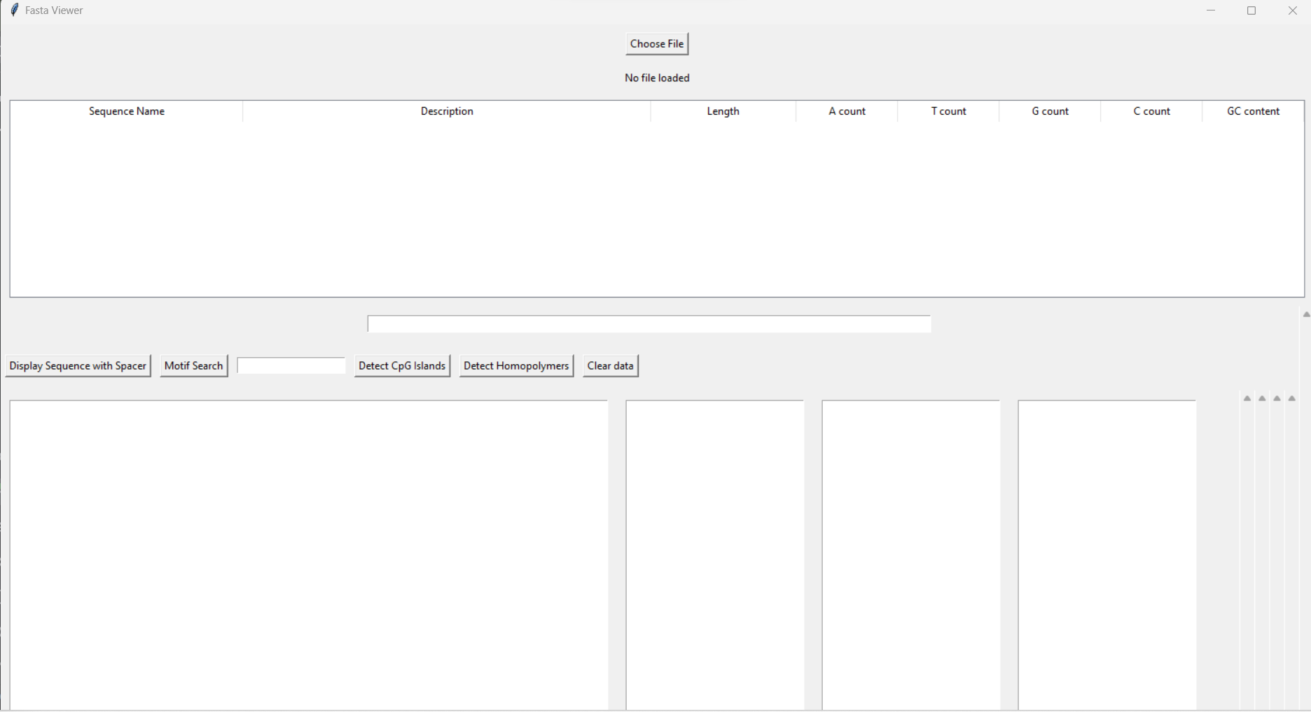
GUI INTERFACE

Slide 6
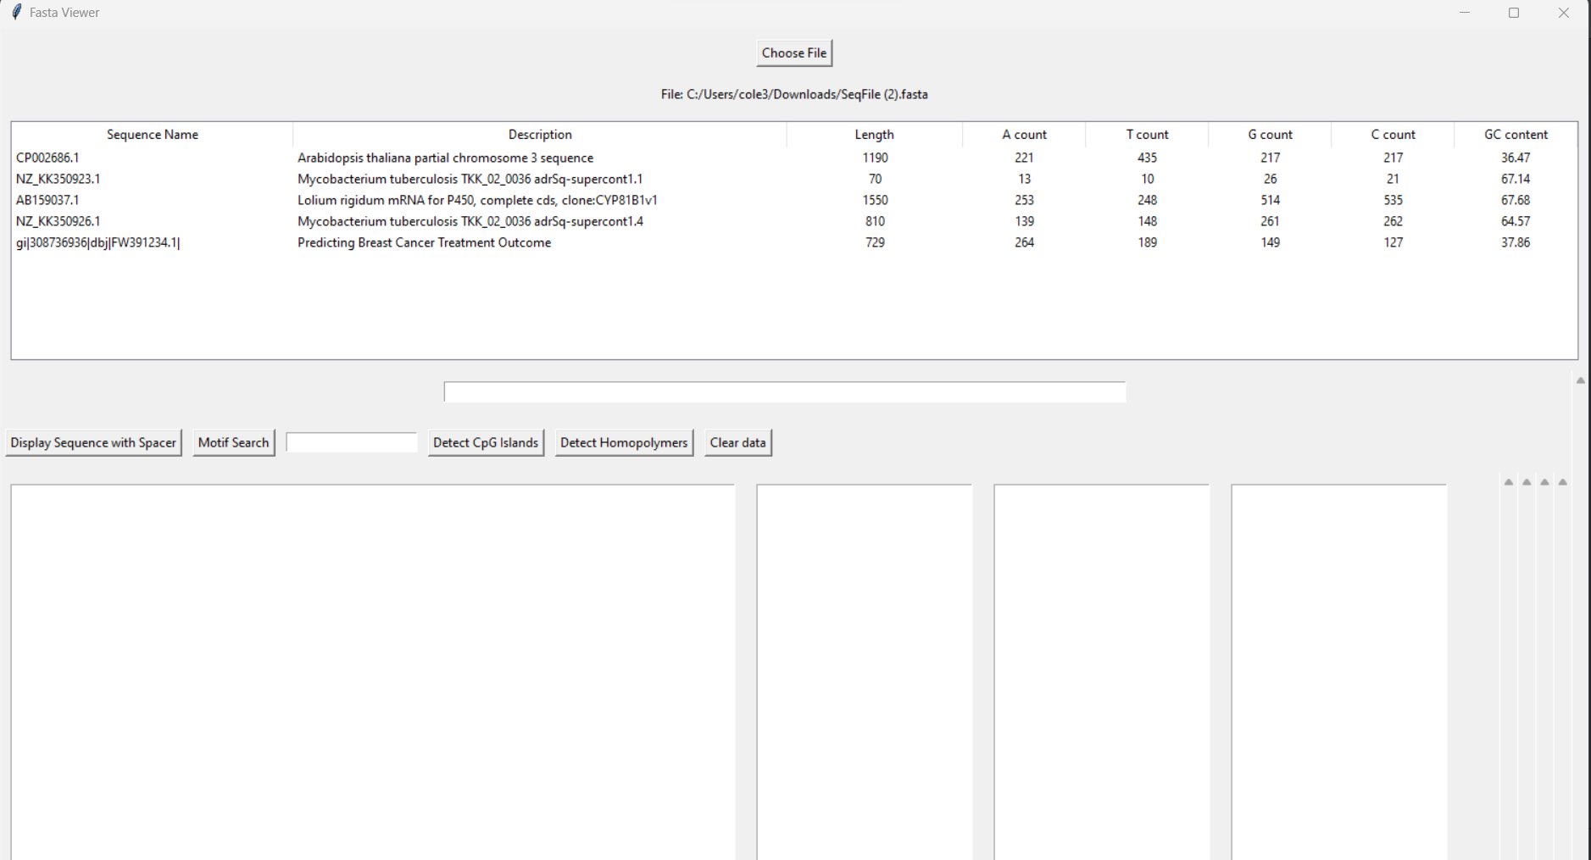

Slide 7
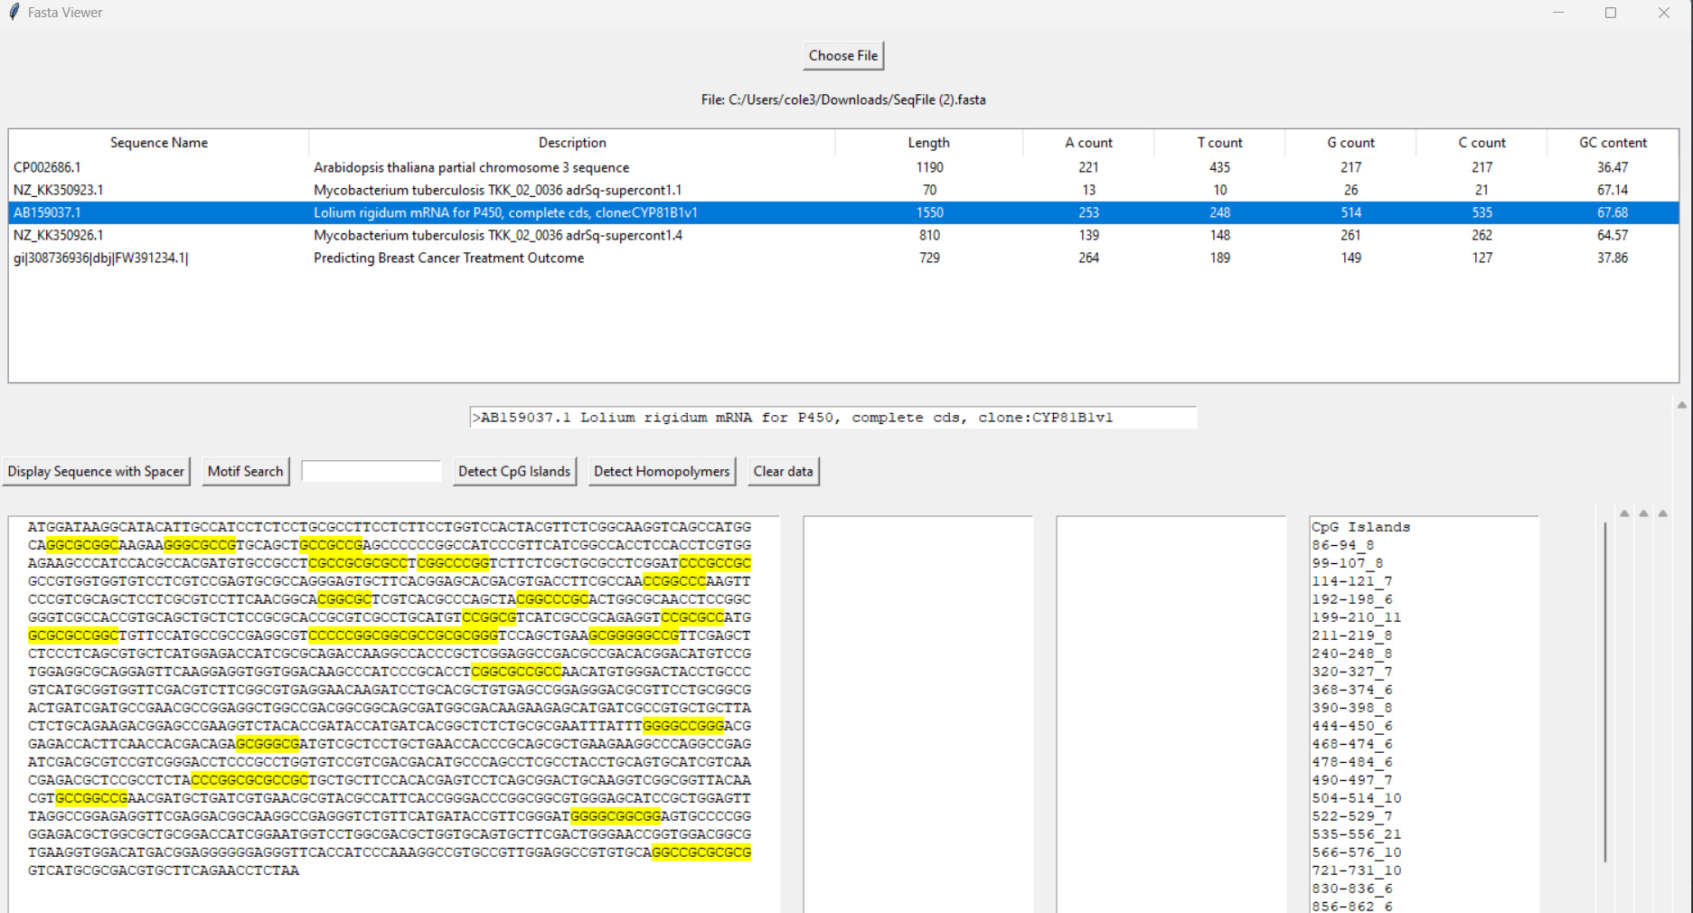

Slide 8
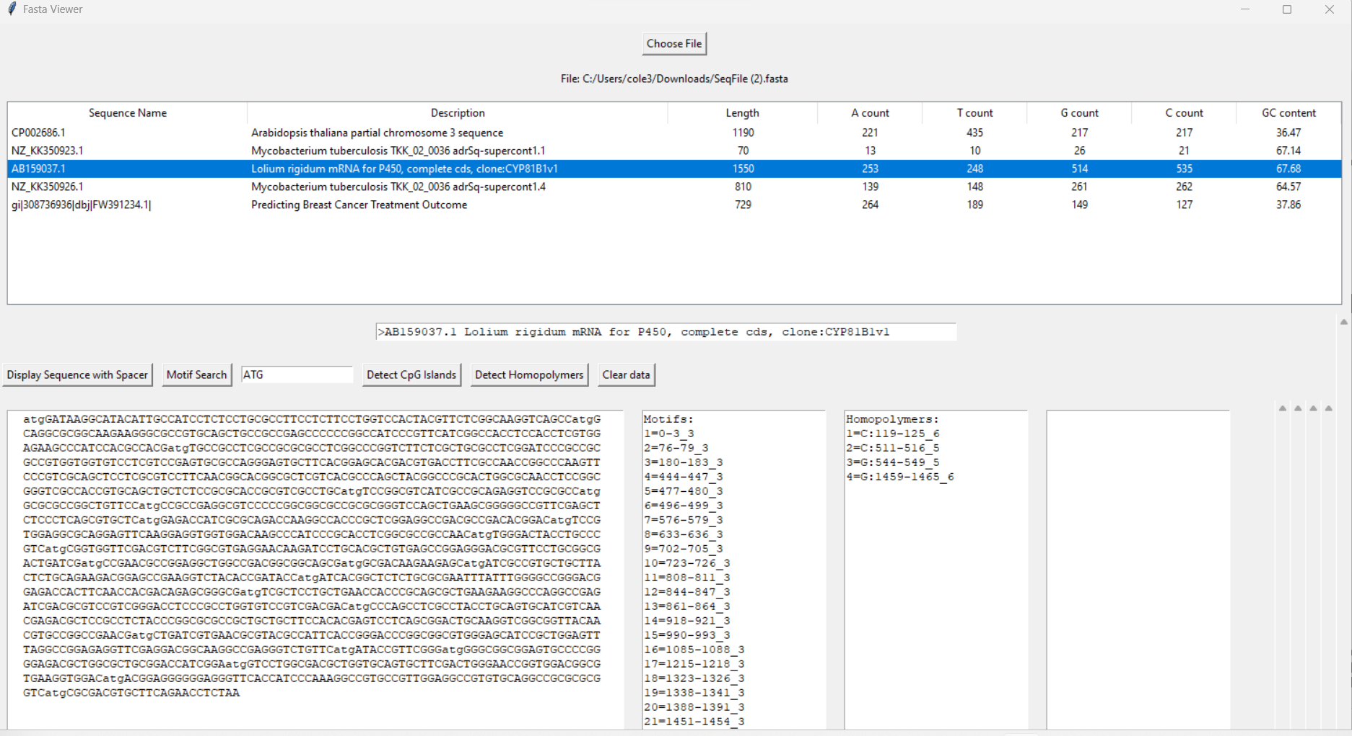

Slide 9
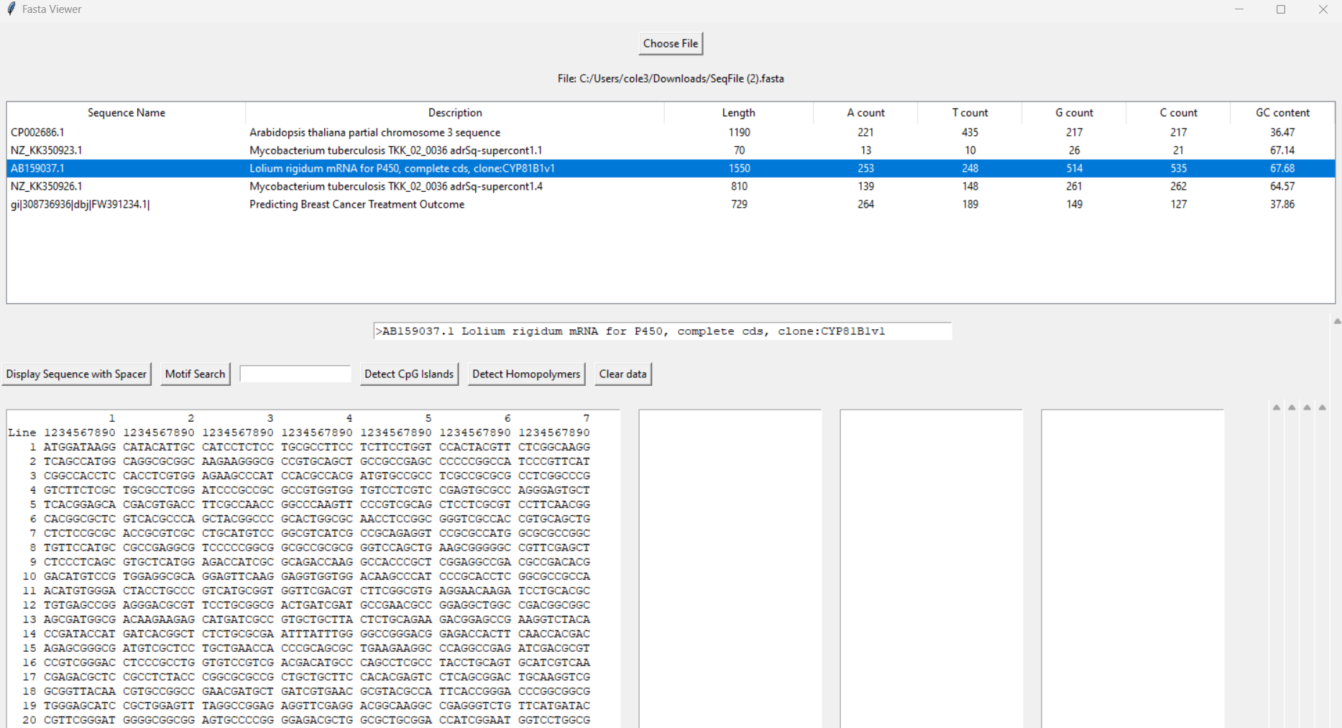

Slide 10
Software implementation
Backend
Numerous Python classes for file reading, data handling, etc.
Integration with GUI and database
Result
Automated data processing
Maintainable design

Slide 11
Moving forward
Potential improvements
Database expansion
Allow larger number of sequences
Future goals
Adapt with needs of those in the bioinformatics field
Opportunity for collaborative research

Slide 12
Conclusion
Achievements
User-friendly GUI
Detailed backend integration
Detailed, user-friendly access for those that are not experts in the subject area
Impact
Advancement in bioinformatics processes
Aiding research in genetics, epigenetics, and molecular biology

Slide 13
THANK YOU!
Questions?

